Slide 1
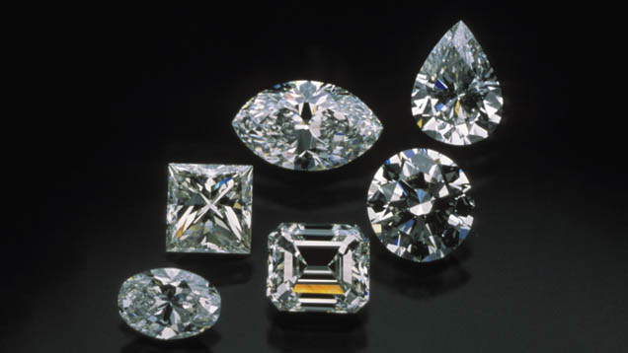
Diamond Analysis and Diamond Price Prediction
- Shriyutha K U

Slide 2
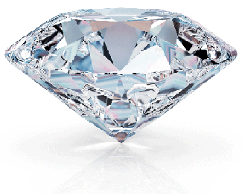


DATASET
There are 11 variables provided in the data set
The dataset used here is Diamonds
from Kaggle
Count : (16383)
Carat : (0.2 – 3.0) - weight
Cut : Fair, Good, Very Good, Premium, Ideal
Color : D, E, F, G, H, I ,J
Clarity : IF, VVS1, VVS2, VS1, VS2, SI1, SI2, I1
Depth : total depth = z / (z * 100)
Table : table = y / (x * 100) - height
Price : (326 – 6541)
X : top length in mm (0 – 9.23)
Y : top width in mm (0 – 9.1)
Z : top depth in mm (0 – 5.77)
https://www.kaggle.com/shivam2503
/diamonds/download

Slide 3
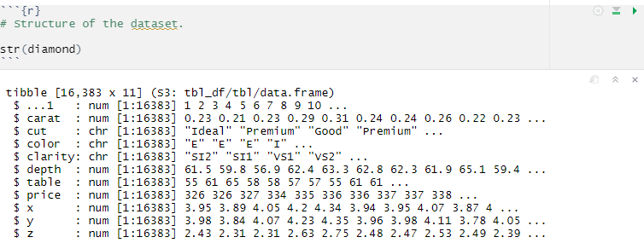
DATASET
Diamond Dataset : 11 columns – 16383 instances

Slide 4
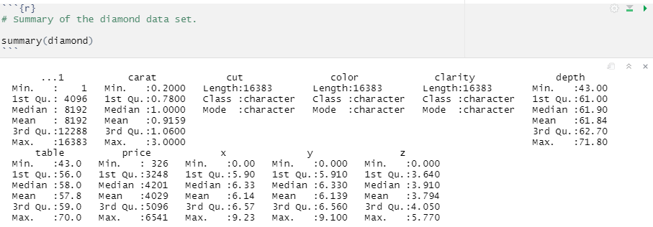
DATASET
Diamond Dataset : 11 columns – 16383 instances

Slide 5
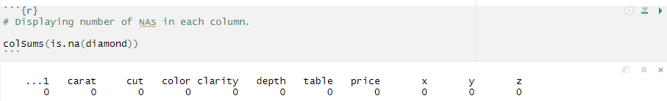
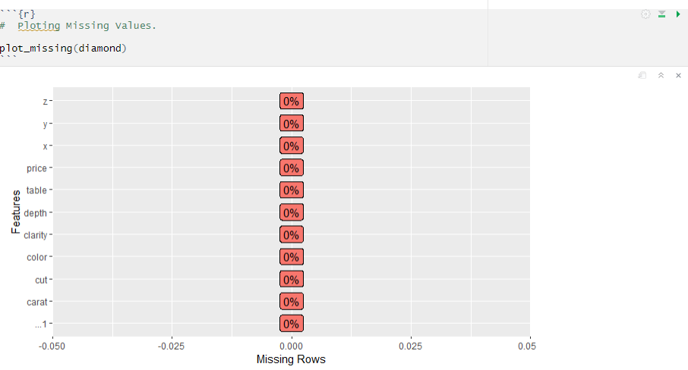
Checking for missing values (NA)
Library(DataExplorer)

Slide 6
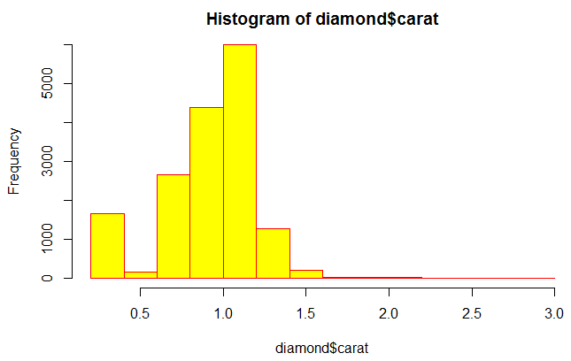
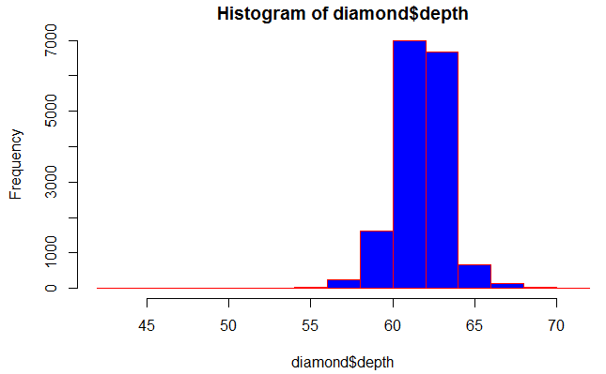
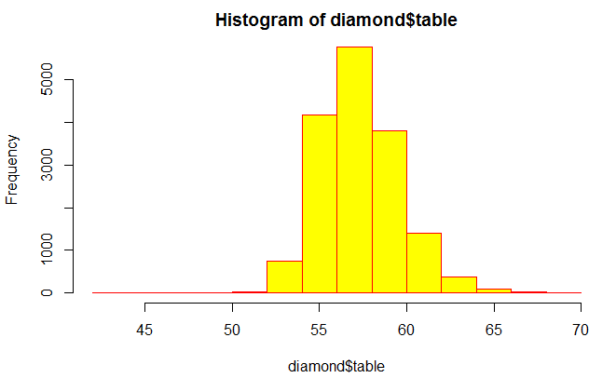
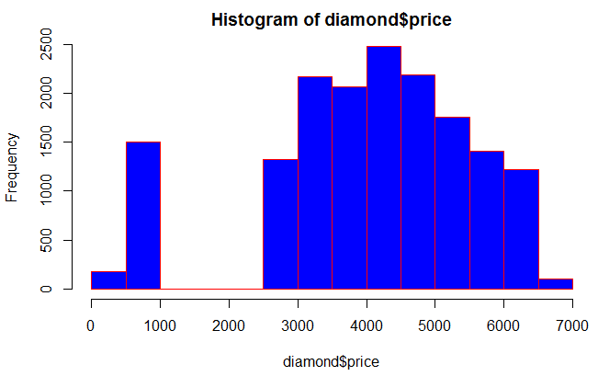
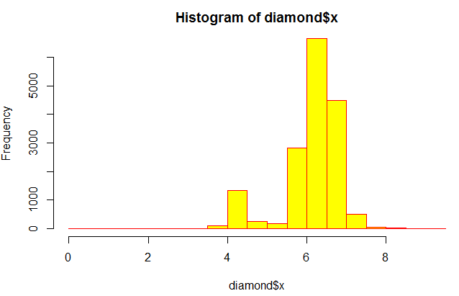
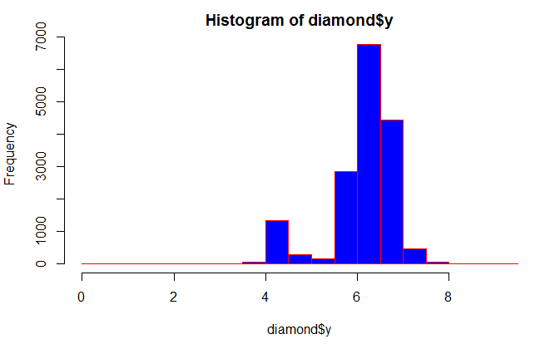
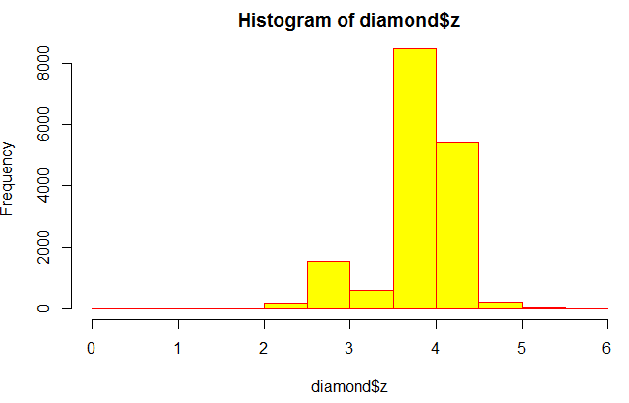
Descriptive Statistics (Histogram Plot Analysis)
hist()

Slide 7
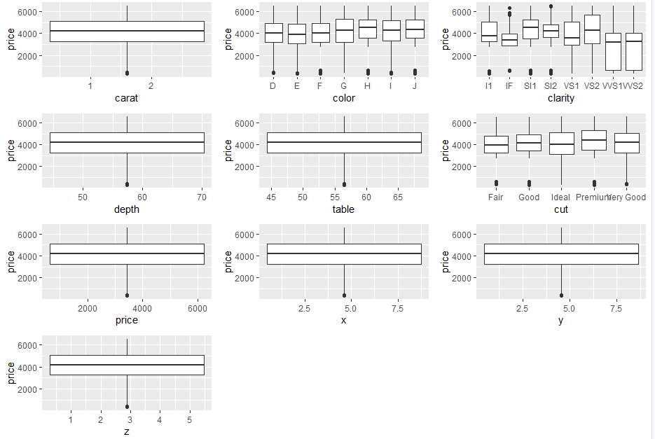
Descriptive Statistics (Box-plot Analysis)
library(ggplot2)

Slide 8
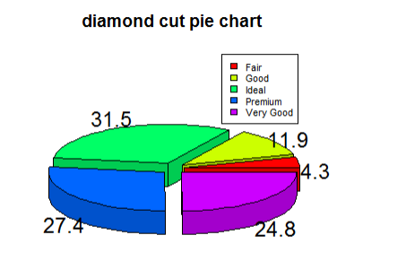
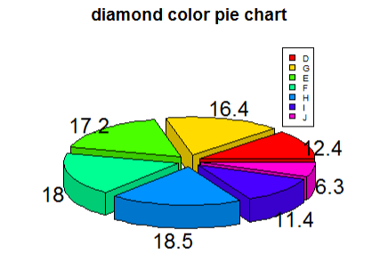

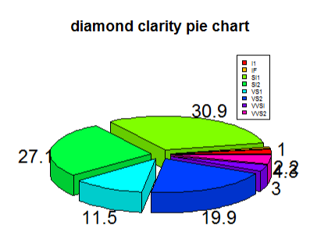


Diagnostic Analysis(Pie Chart)
pie3D()

Slide 9
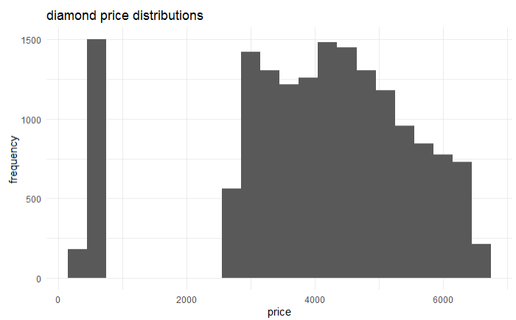
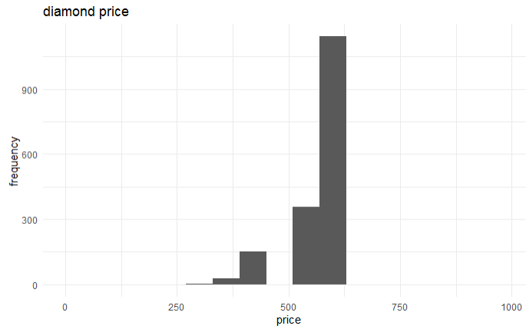
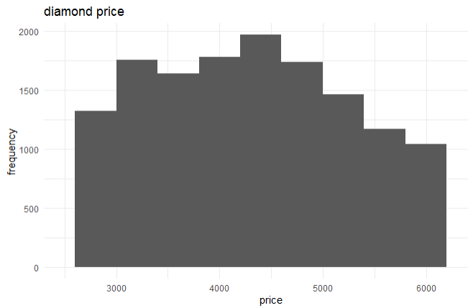
Histogram Plot Analysis

Slide 10
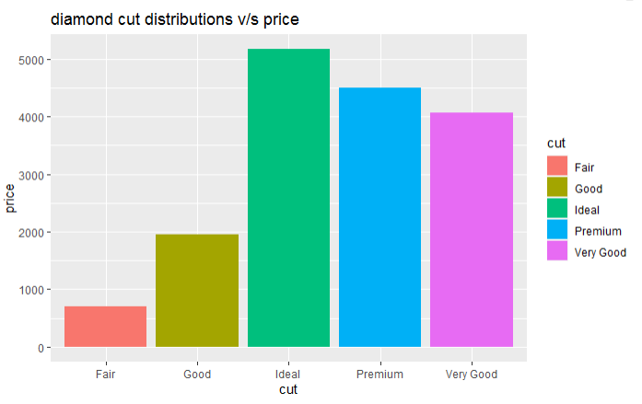
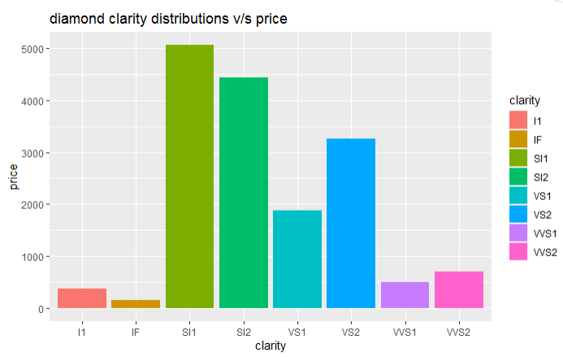
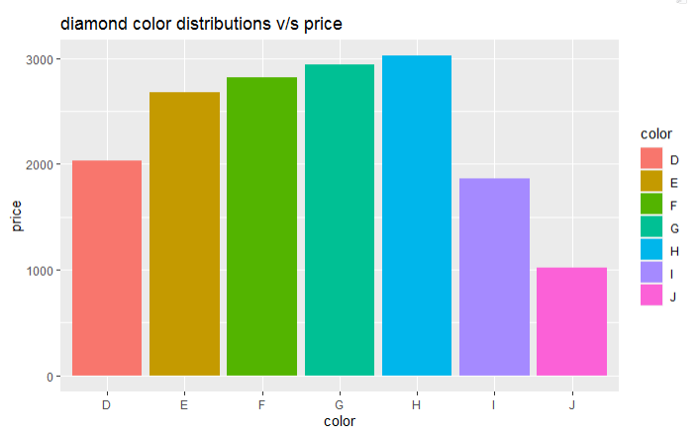
Bar - plot Analysis

Slide 11
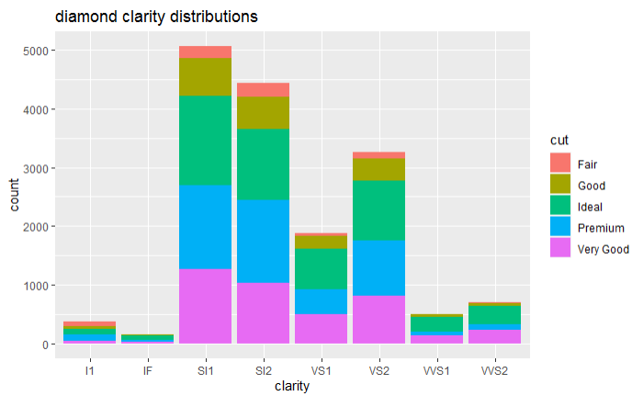
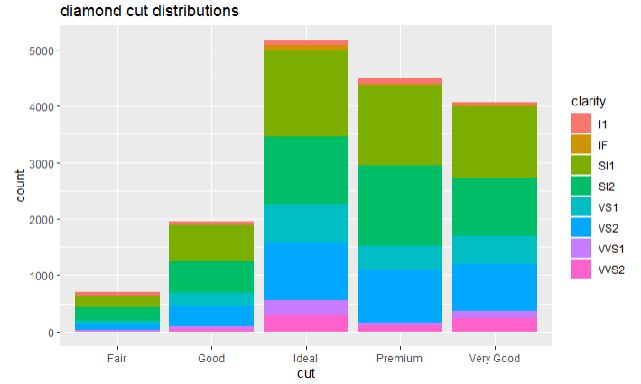
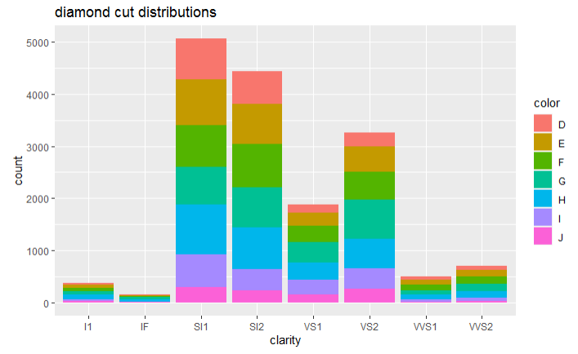
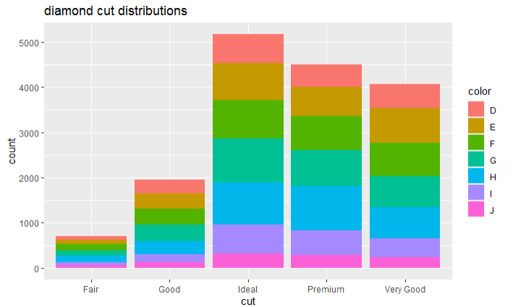
Bar - plot Analysis

Slide 12
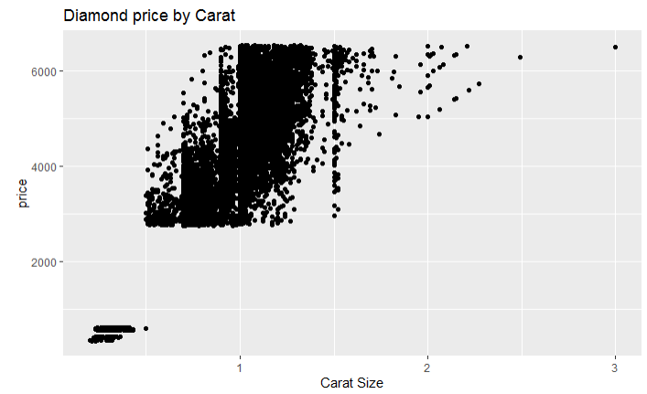
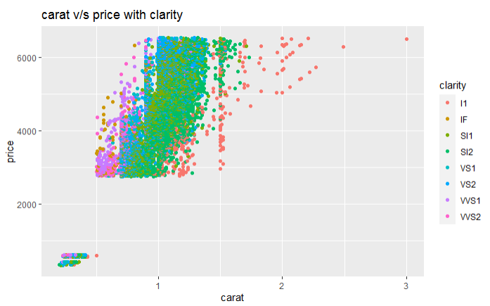
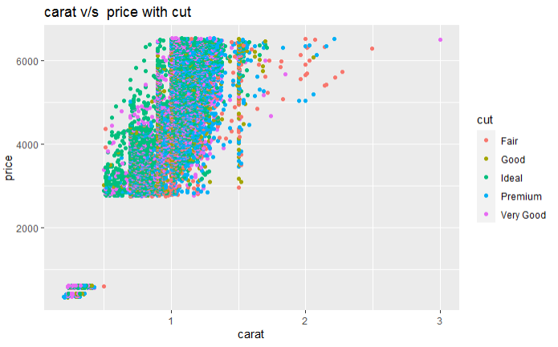
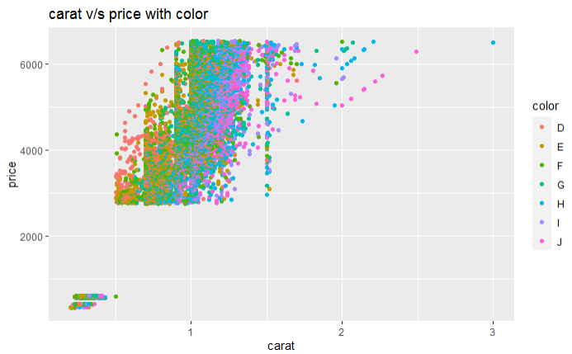
Scatter - plot Analysis

Slide 13
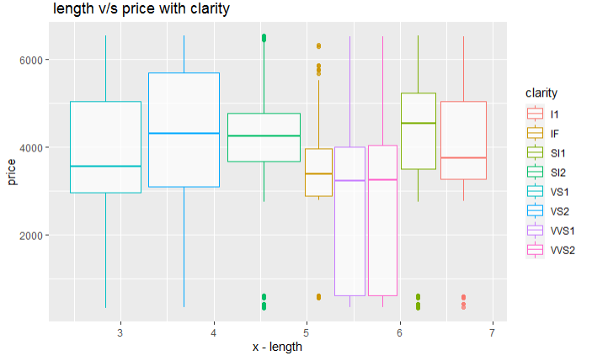
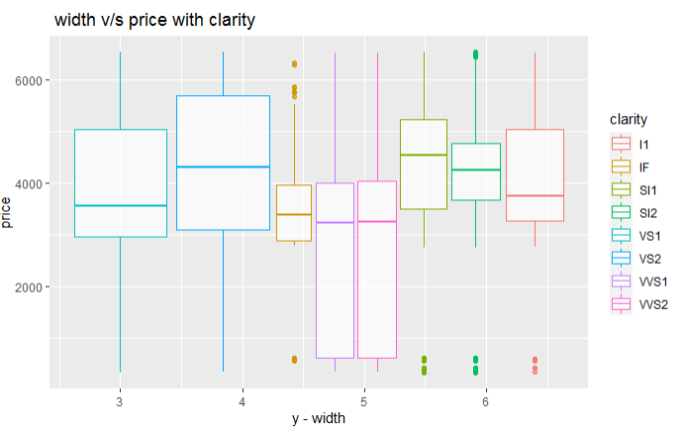
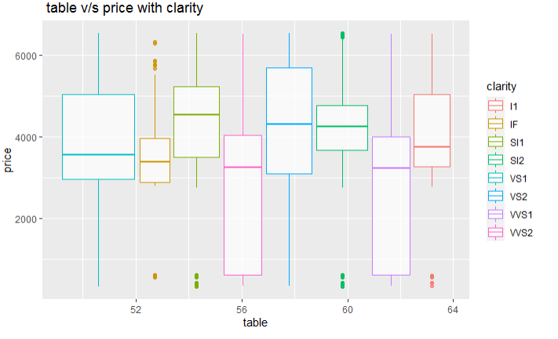
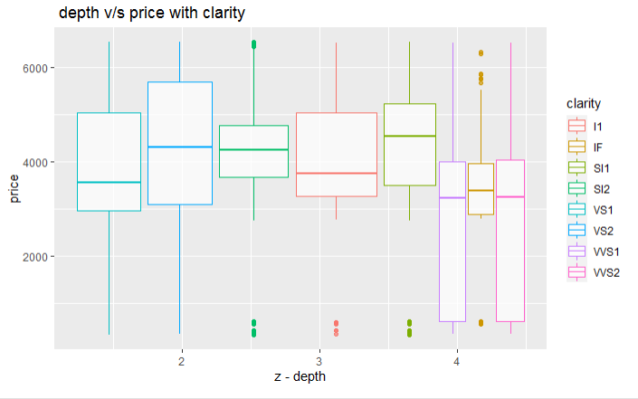
Box-plot Analysis

Slide 14
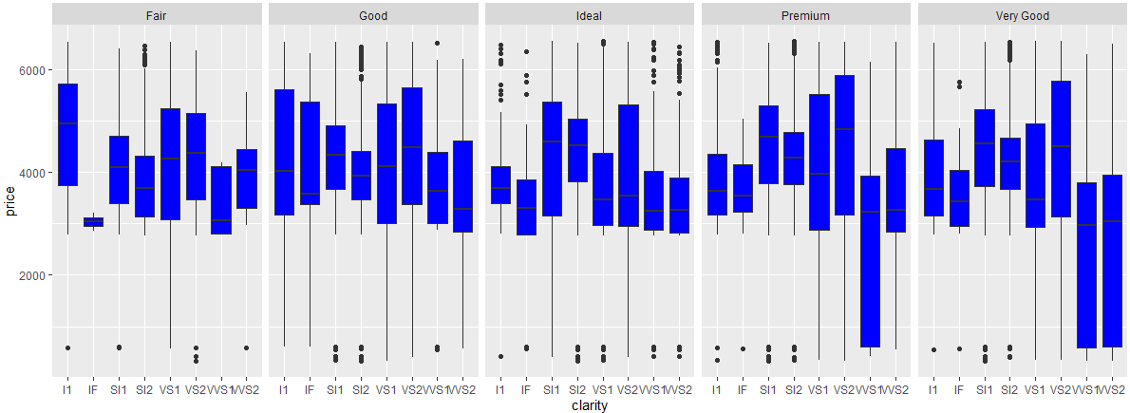
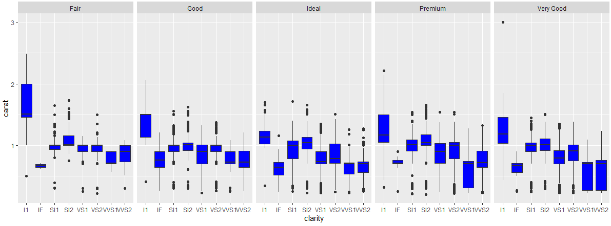
Box-plot Analysis

Slide 15
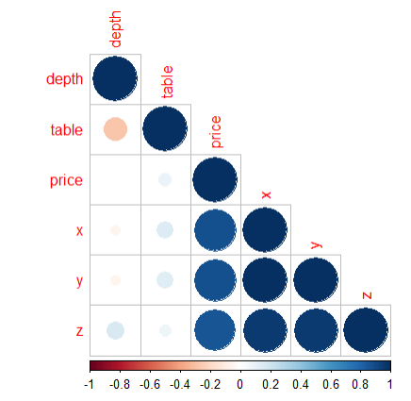
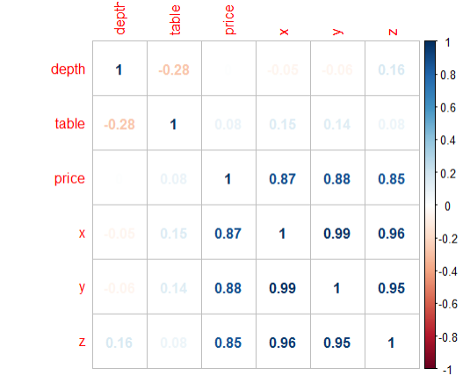
PREDICTIVE MODELING Correlation Matrix
Library (corrplot)

Slide 16
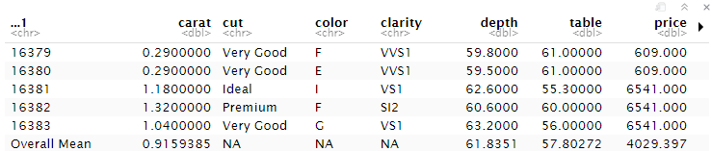
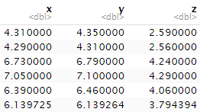
DIAGNOSTIC ANALYSIS Mean Values Respect to Diamond count rbind - function

Slide 17
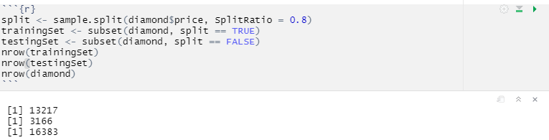
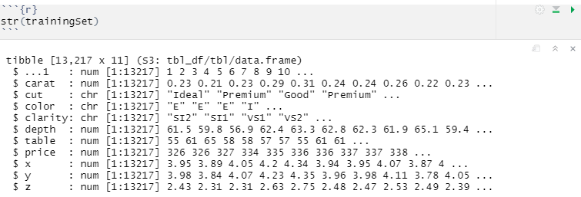
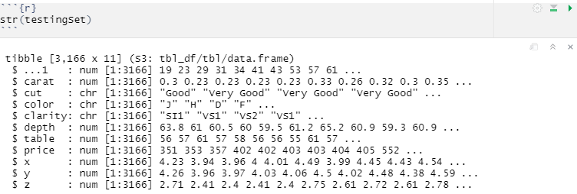
PREDICTIVE MODELING Splitting Data for Training (80%) and Testing (20%)
Training Data
80 %
Testing Data
20 %
Library (caTools)

Slide 18
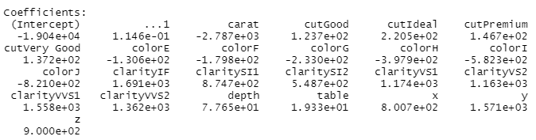

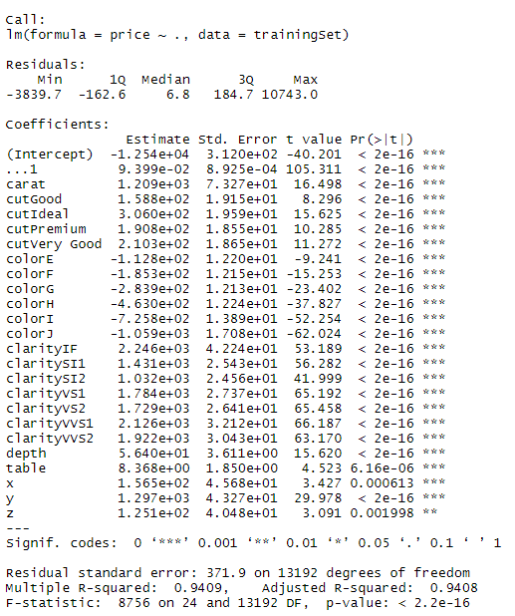

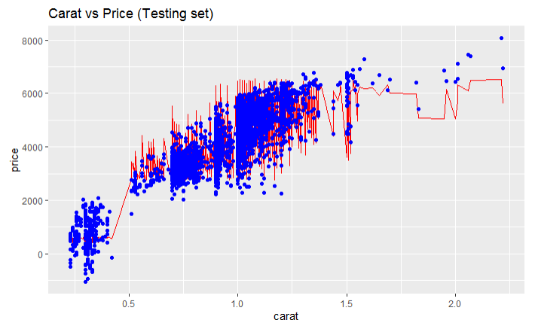
PREDICTIVE MODELING LINEAR REGRESSION
Model Coefficients
Accuracy
Library (caret)

Slide 19
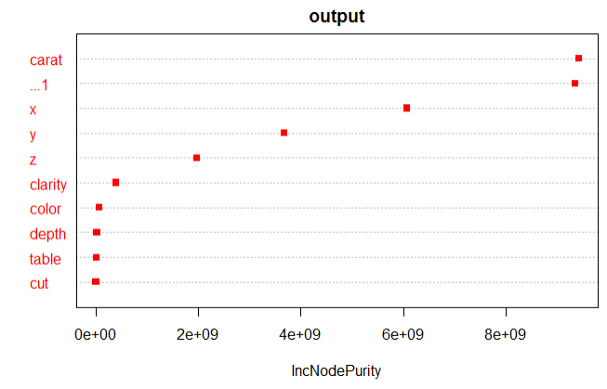
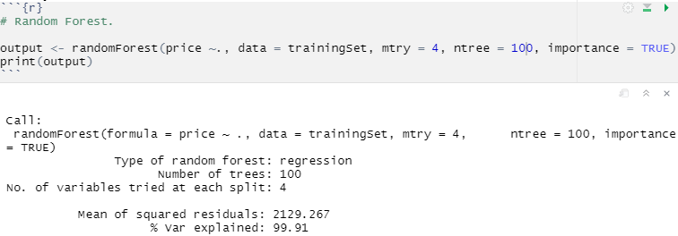
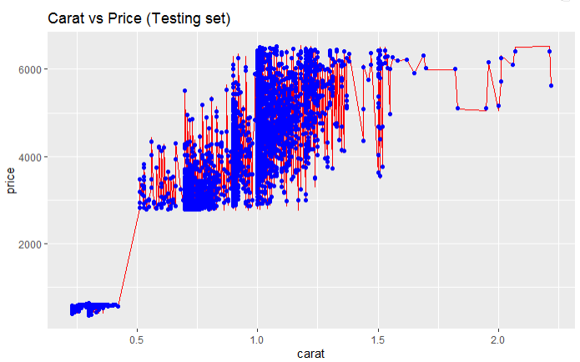

PREDICTIVE MODELING RAMDOM FOREST
varImpPlot
Accuracy
Library (randomForest)

Slide 20





PREDICTIVE MODELING DECISION TREE MODEL
Accuracy
Library (rpart)

Slide 21

Predicted Results
Library (caret)

Slide 22


CONCLUSION
If you want to buy a diamond with highest price , you should look for these values.
If you want to buy a diamond with lowest price , you should look for these values.
Carat , cut and clarity are the primary factor responsible for variation of price
Price of diamond linearly correlated with x, y, z and carat.
Random forest Model works better than Linear Regression and Decision tree model.
If you want to buy a high quality diamond, you should look for these values.

